Slide 1
How to prepare a successful proposal in Horizon Europe
The rules of the game – the Model Grant Agreement
24 March 2021
HE MGA Team - Common Legal Support Centre, DG R&I, European Commission

Slide 2




What is the grant agreement and why do I need it?
The grant agreement is the contractual document signed with a ‘granting authority’ (e.g. the Commission or one of its executive agencies) defining
  Your rights
  e.g.:
  To receive EU funding, under the terms and conditions defined in the grant agreement, to help you to accomplish your project
  To own the results of the project that you have generated
  To ask for amendments of the grant agreement (if something needs to be changed)
  YOUR OBLIGATIONS
  e.g.:
  To Implement the project as planned in the description of the action (Annex 1 to the grant agreement)
  Submit reports at the time and for the periods defined in the grant agreement
  Display the EU emblem and reference to Horizon Europe funding (e.g.information material, equipment funded by the grant, major results);
  How much money you can get
  Overall, the granting authority can never pay
  more than the maximum grant amount fixed in the grant agreement.
  But it may pay less; e.g. if the project costs at the end are less than budgeted

Slide 3
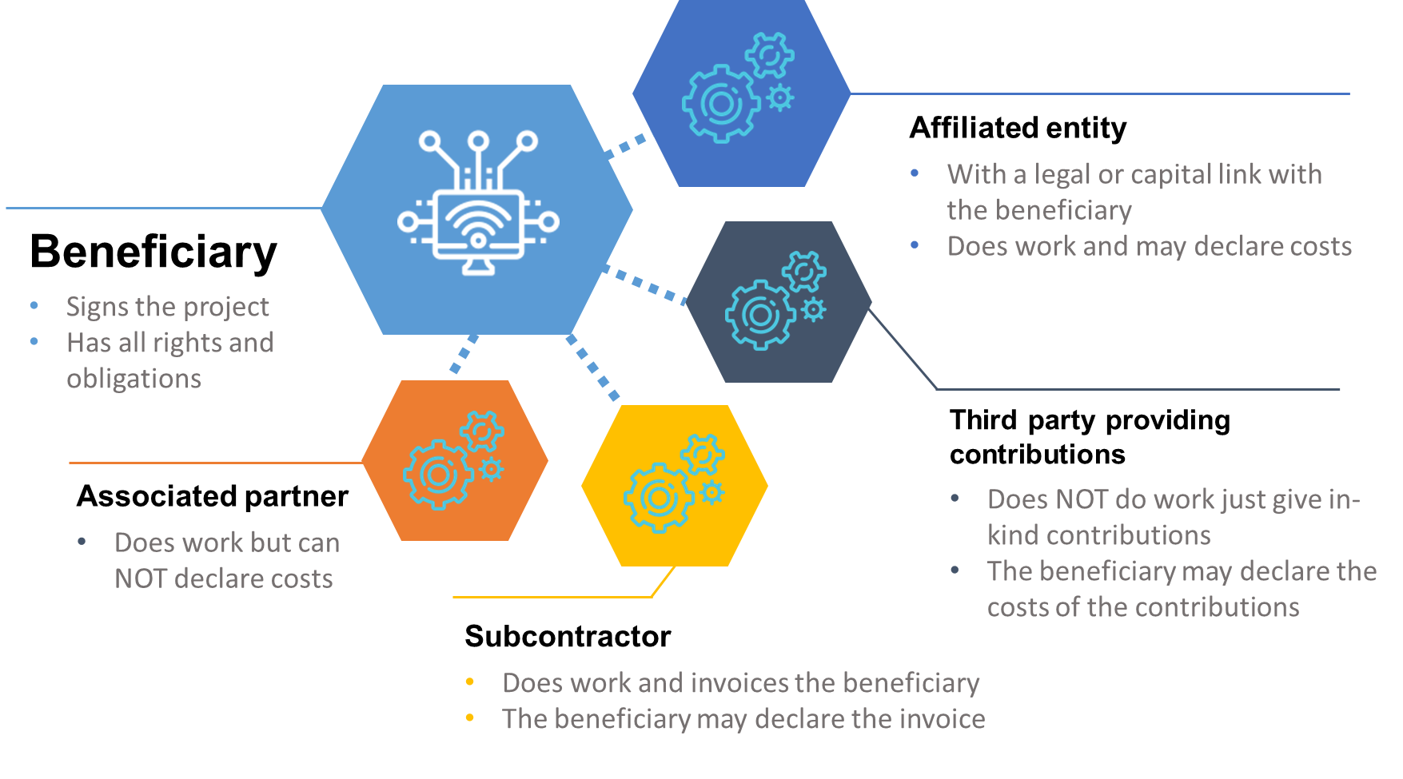
How can I participate in the grant agreement?

Slide 4



How does the Horizon Europe grant agreement look like?
  e-grant
  The Horizon Europe grant agreement and its management are fully electronic. This is from the signature of the grant until its end, all actions and communications will flow via the Funding & Tenders Portal (‘the Portal’).
  CORPORATE STRUCTURE
  The Horizon Europe grant agreement is based on a Commission-wide model (so-called ‘Corporate Model Grant Agreement’)
  specific annex 5
  Some important Horizon Europe specific rights and obligations are part of this annex 5, like:
  Security
  Ethics
  Values (i.e. gender mainstreaming)
  IPR
  Communication, Dissemination, Open Science and Visibility
  Specific rules for carrying out the action

Slide 5
The Model Grant Agreement
The corporate approach

Slide 6

Corporate features of the Horizon Europe MGA
  more user-friendly structure and readability
Improved content
& features
Alignment with new Financial Regulation
(FR 2018)
  reporting explicitly divided into continuous and periodic reporting
  Amendment procedure for BEN termination, GA suspension + GA termination by consortium (instead of Formal Notification)
  less descriptive provisions (reference to published templates)
  reduction/suspension/
  termination grounds
  Receipts (only for profit legal entities)
  Data Sheet
  Common numbering
  Common labelling (‘granting authority’; ‘affiliated entity’)
  Grouping of provisions for
  Types of participants and their roles
  Rules concerning project implementation
  Payments and recoveries
  Certificates (CFS, SPA)
Disclaimer: Information not legally binding

Slide 7

Corporate structure of the HE MGA
Core Part
Datasheet
a summary of the specific data of the grant agreement
Articles
grouped in six chapters
1. General Data
2. Participant
3. Grant
4. Reporting, payment and recoveries
5. Consequences of non-compliance, applicable law and dispute settlement forum
6. Specific rules Annex 5 & Standard time-limits after project end
Chapter 1 – General (Articles 1-2)
Chapter 2 – Action (Articles 3-4)
Chapter 3 – Grant (Articles 5-6)
Chapter 4 – Grant Implementation (Articles 7-26)
Chapter 5 – Consequences of non-compliance (Articles 27-35)
Chapter 6 – Final provisions (Articles 36-44)
Disclaimer: Information not legally binding

Slide 8





Corporate structure - Annex 2 (general HE MGA cost categories)
  A. Personnel costs
    A.1 Employees
    A.2 Natural persons under direct contract
    A.3 Seconded persons
    A.4 SME owners and natural person beneficiaries
  B. Subcontracting costs
  C. PURCHASE COSTS
    C.1 Travel and subsistence
    C.2 Equipment
    C.3 Other goods, works and services
  d. OTHER COST CATEGORIES
    D.1 Financial support to third parties
    D.2 Internally invoiced goods and services
    [D.3 Transnational access to research infrastructure unit costs]
    [D.4 Virtual access to research infrastructure unit costs]
    [D.5 PCP/PPI procurement cost]
    [D.6 Euratom Cofund staff mobility costs]
    [D.7 ERC additional funding]
    [D.8 ERC additional funding (subcontracting, FSTP and internally invoiced goods and services)]
  E. INDIRECT costs

Slide 9

Corporate Structure – Annex 5 (for Horizon Europe)
Annex 5 Special Rules
Security (Article 13)
Ethics (i.e. research integrity) (Article 14)
Values (i.e. gender mainstreaming) (Article 14)
IPR (Article 16)
Communication, Dissemination, Open Science and Visibility (Article 17)
Specific rules for carrying out the action (Article 18)
    recruitment and working conditions,
    specific rules for access to research infrastructure actions,
    specific rules for PCP and PPI procurements,
    specific rules for co-funded partnerships,
    specific rules for ERC actions,
    specific rules for EIT-KIC actions,
    specific rules for MSCA actions
    specifc rules for EIC actions
Disclaimer: Information not legally binding

Slide 10
Horizon Europe
Model Grant Agreement
MAIN LEGAL AND FINANCIAL NOVELTIES OF

Slide 11
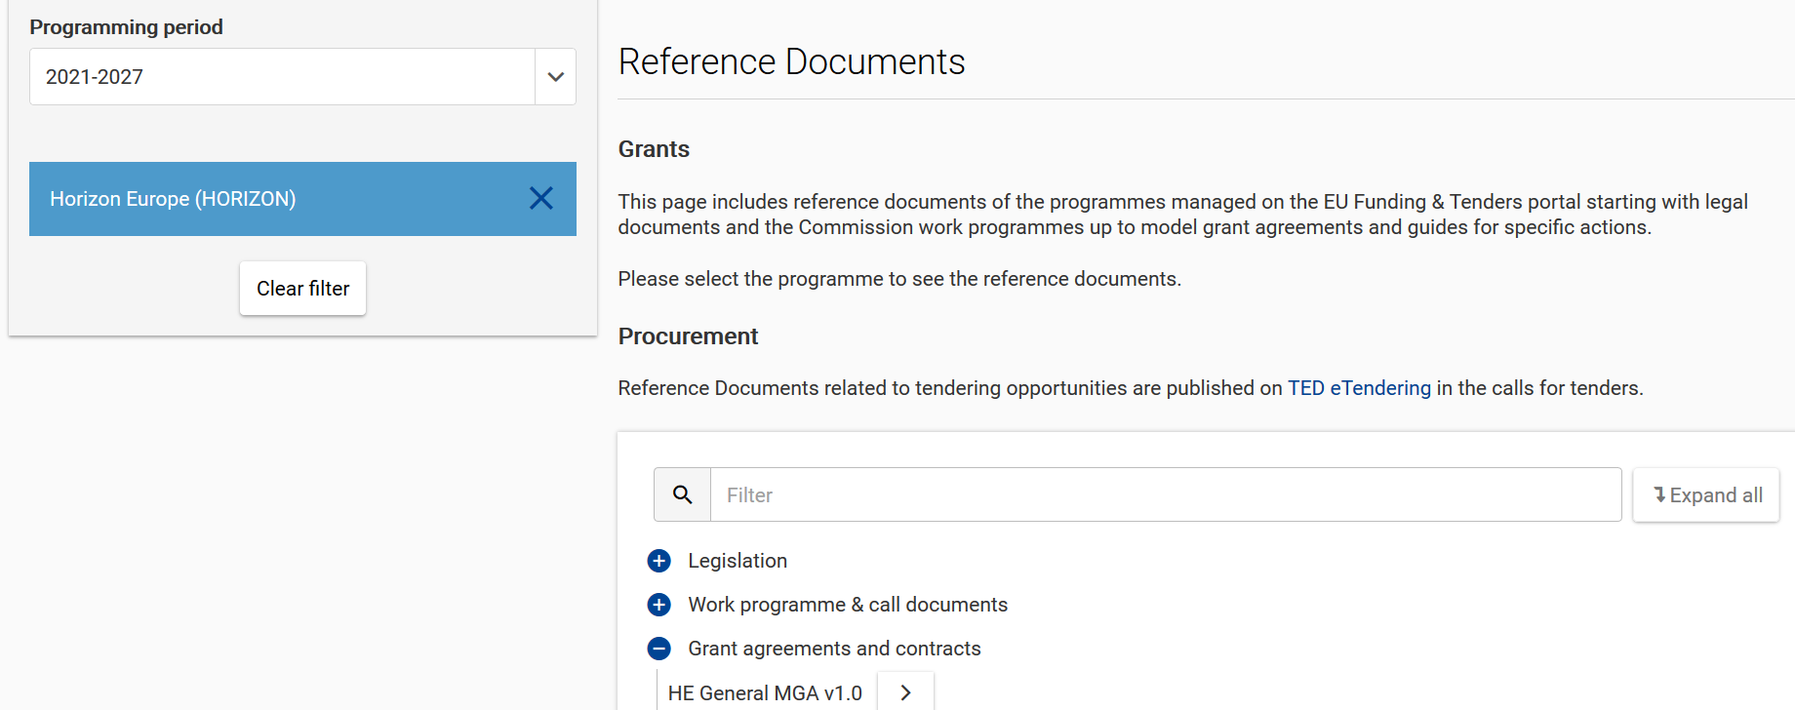
Horizon Europe General MGA
Version 1 published on 25 February 2021 on the Funding and Tenders Portal

Slide 12
Main changes at a glance
Certificate
Affiliated
Entity
Associated Partner
Open Science
IPR & Exploitation
Systems and Process Audit (NEW)
Change of terminology
Third party specific status
Enhanced practices
Horizon Results Platform
In-kind contributions against payment
Indirect costs
CFS Thresholds
Personnel costs
Internal Invoicing
Overall continuity with 25% flat-rate
(with exceptions)
Corporate
daily rate
Actual indirect costs
No more specific Article
Higher tresholds
Corporate MGA
Terminology, Data Sheet & Annex 5

Slide 13
Horizon Europe Model Grant Agreement
THIRD PARTIES

Slide 14


Affiliated entities
Article 187 (1)(b) of the EU Financial Regulation:
Entities ‘that have a link with the beneficiary, in particular a legal or capital link, which is neither limited to the action nor established for the sole purpose of its implementation’.
Affiliated entities in Horizon Europe = Linked third parties in Horizon 2020
(alignement of labelling/definition in the corporate context)
Disclaimer: Information not legally binding

Slide 15
Associated Partner (AP)
Inherited and derived from the ‘International partner’ status in H2020 MGA
Corporate terminology and status with the following features:
AP does work but cannot declare costs
AP can be linked:
  either to one or more beneficiaries
  or with the whole consortium
The beneficiaries must ensure that some of MGA obligations also applied to AP (i.e. Articles 11 (proper implementation), 12 (conflict of interests), 13 (confidentiality and security), 14 (ethics), 17.2 (visibility), 18 (specific rules for carrying out action), 19 (information) and 20 (record-keeping)

Slide 16
General case – Corporate daily rate provisions
PERSONNEL COSTS

Slide 17
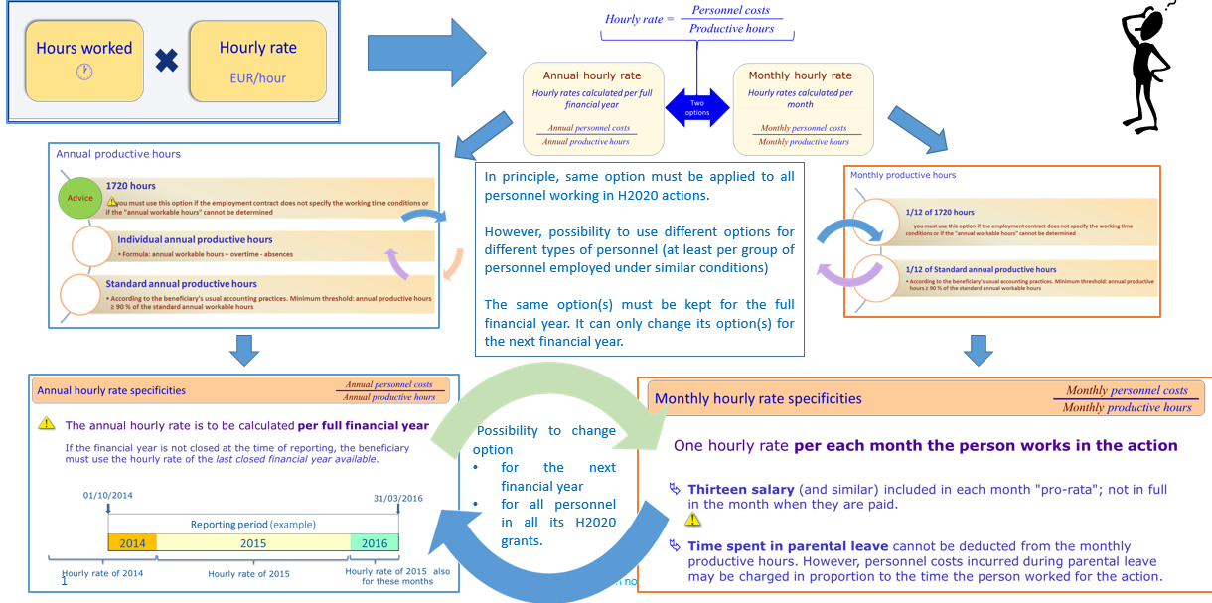
Horizon 2020: a snapshot of the situation

Slide 18

Personnel costs – new calculation
Discontinuation of the different formulas (annual and monthly) and options for productive hours (entailing difficult and error-prone calculations)
No more ‘last closed financial year’ rule
Instead, use of a single corporate daily rate and calendar year approach
Days worked
in the project
Personnel costs
Daily rate

Slide 19
Daily rate calculation
        actual annual personnel costs for the person
        215*
Daily rate
*For Horizon Europe: Still possible to deduct actual working days spent on parental leave from the fixed number of 215 days
Disclaimer: Information not legally binding

Slide 20
Daily rate calculation
When?
per calendar year (from January to December)
except for the months running from the end of the last calendar year until the end of the reporting period. For those months, you must calculate a separate partial daily rate as follows:
  {actual personnel costs of the person incurred over those months
  divided by
  {215 / 12 (months) x number of months from the January until the end of the reporting period}}

Slide 21
Example
2021
actual personnel costs incurred for that person in 2021
215
X
days worked by that person on the action from 1/09/2021
2022
actual personnel costs incurred for that person in 2022
215
X
days worked by that person on the action in 2022
2023
actual personnel costs incurred for that person until 31/03/2023
(215 / 12 x 3)
X
days worked by that person on the action until 31/03/2023
Costs for Researcher Y in reporting period 1. Reporting period 1 runs from 1/09/2021 until 31/03/2023:
Personnel Costs RP1

Slide 22
Days worked – record keeping
use reliable time records (i.e. time-sheets) either on paper or in a computer-based time recording system.
Or
sign a monthly declaration on days spent for the action (template under development).
Days worked
Disclaimer: Information not legally binding

Slide 23

Time recording system in hours
‘Day-equivalent’ → 3 conversion rules at hand
A conversion based on the average number of hours that the person must work per working day according to her/his contract.
  Example: if the contract says that the person must work 37,5 hours per week distributed in 5 working days, a day-equivalent for the person is 7,5 hours (37,5 / 5). In the same example, if the person works 50 % part-time, the day-equivalent would be 3,75 hours ( 18,75 / 5).
A conversion based on the usual standard annual productive hours of the beneficiary, if it is at least 90% of the workable time (i.e. continuity with H2020)
  Example:
  Standard annual productive hours of the beneficiary = 1600 Standard annual workable hours of the beneficiary = 1720
  1720 x 90% = 1548 < 1600
  1600/215 => 7.44 hours = 1 day-equivalent
A conversion based on a fixed number of hours (e.g. for beneficiaries with no reference in their contracts nor standard annual productive hours):
1 day-equivalent = 8 hours
Disclaimer: Information not legally binding

Slide 24
Time recording system in hours
‘Day-equivalent’: When to do the conversion?
Each time that you have to calculate a daily rate → per calendar year
  For example at the time of a reporting period:
  If a daily rate is calculated for year 2021, the beneficiary must convert into day-equivalents the total number of hours worked by the person on the action during 2021 altogether.
Disclaimer: Information not legally binding

Slide 25
Main differences with Horizon 2020
Discontinuation of the different formulas (annual and monthly) and options for productive hours (entailing difficult and error-prone calculations)
No more ‘last closed financial year’ rule
Instead, use of a single corporate daily rate and calendar year approach

Slide 26
Horizon Europe specific provisions
PROJECT-BASED REMUNERATION

Slide 27





Project-based remuneration at a glance
  What is it?
  Usual remuneration practices of a legal entity under which a personnel receives supplementary payments for work in projects
  How MUCH CAN BE DECLARED?
  Actual remuneration costs paid by the legal entity for the time worked by the personnel in the action (‘action daily rate’) up to the remuneration that the person would be paid for work in R&I projects funded by national schemes (‘national projects daily rate’)
  METHODOLOGY?
  Compare
  Take the lower of the two.
*
Example:
an employee who gets a bonus or a new contract with a higher salary level for working in a project.
*
Usually based on:
either regulatory requirements (such as national law or collective labour agreements)
or your written internal remuneration rules

Slide 28
Horizon Europe specific provisions
Internally invoiced goods & services

Slide 29
Internal invoicing
What?
Costs for goods and services which are produced or provided within the beneficiary’s organisation directly for the action and the beneficiary values on the basis of its usual cost accounting practices.
Examples:
  self-produced consumables (e.g. electronic wafers, chemicals)
  specialised premises for hosting the research specimens used for the action (e.g. animal house, greenhouse, aquarium)
  standardised testing or research processes (e.g. genomic test, mass spectrometry analysis)
  use of specific research devices or research facilities (e.g. clean room, wind tunnel, supercomputer facilities, electronic microscope)
Wider reliance on beneficiary’s usual cost accounting practices for the unit cost calculation with:
  No application of the 25% flat-rate on top of the unit cost (H2020 rules)
  instead, possibility to accept actual indirect costs allocated via beneficiary’s usual key drivers in the unit cost calculation
NEW

Slide 30
Horizon Europe specific provisions
In-kind contributions

Slide 31
In-kind contributions – both still eligible under HE
  in-kind contributions against payment
  No more special Article (corporate approach):
  But they can still be declared as:
  Seconded persons under Personnel costs provisions
  Other types as purchase of goods, works or services
  Indirect costs calculated on top via the 25% flat-rate
  in-kind contributions free of charge
  Specific provisions (Art 6(1) & Art 9(2)) HE MGA (stemming from Horizon Europe specific legal base)
  They must be declared under the relevant cost category (i.e. as if they were costs incurred by the beneficiary).
  Only direct costs must be reported
  Indirect costs calculated on top via the 25% flat-rate (with exceptions, like for internal invoicing)

Slide 32
Horizon Europe specific provisions
receipts

Slide 33
Receipts under Horizon Europe
Corporate approach → Alignment with the revised
Financial Regulation (FR 2018)
Article 192(2) FR
[…] receipts are limited to the Union grant and the revenue generated by that action or work programme.
Article 192(3)(c) FR
→ non-profit organisations are NOT concerned by receipts.
Horizon Europe derogation → Income generated by the exploitation of the results shall NOT be considered as receipts of the action (Art 36(2) HE RfP → continuity with H2020)

Slide 34
Horizon Europe specific provisions
Equipment costs

Slide 35
Equipment costs
Depreciation costs are by default eligible.
By exception, full costs may be eligible.
Optional provisions addressing the specific case of assets under construction (e.g. prototype) and their related capitalised costs:
The full construction costs (typically the costs of the personnel involved in the construction of the prototype)
The full purchase costs (typically any component, pieces of equipment bought for the prototype)
Continuity
Further clarity

Slide 36
Horizon Europe specific provisions
indirect costs

Slide 37
Indirect costs
What?
Costs that are only indirectly linked to the action implementation
(Art. 6(1) General eligibility conditions of the Horizon Europe MGA)
continuity
Flat-rate of 25% of the eligible direct costs, except subcontracting costs, financial support to third parties and exempted specific cost categories, if any.
(Art. 6(2)(E) Indirect costs of the Horizon Europe MGA)
NEW
  Possibility to accept actual indirect costs allocated via beneficiary’s usual key drivers in the unit cost calculation for internally invoiced goods and services

Slide 38
Horizon Europe specific provisions
Certificate on financial statements (CFS)

Slide 39


Certificate on financial statements (CFS)
ALIGNMENT WITH CORPORATE APPROACH
  higher threshold
  EUR 430 000 (increased from EUR 325 000 in H2020)
  CFS to be submitted at payment of the balance
  Simpler calculation base
  Requested EU contribution calculated on all costs (not only actual costs and unit costs calculated in accordance with usual costs accounting practices as in H2020)
  Less cfs for LOW-RISK BENEFICIARIES WITH SPA
  For beneficiaries with a low-risk classification after a SPA the threshold will increase to EUR 725 000 (from EUR 430 000)

Slide 40
Horizon Europe specific provisions
SYSTEMS and PROCESSES AUDITS (SPA)

Slide 41
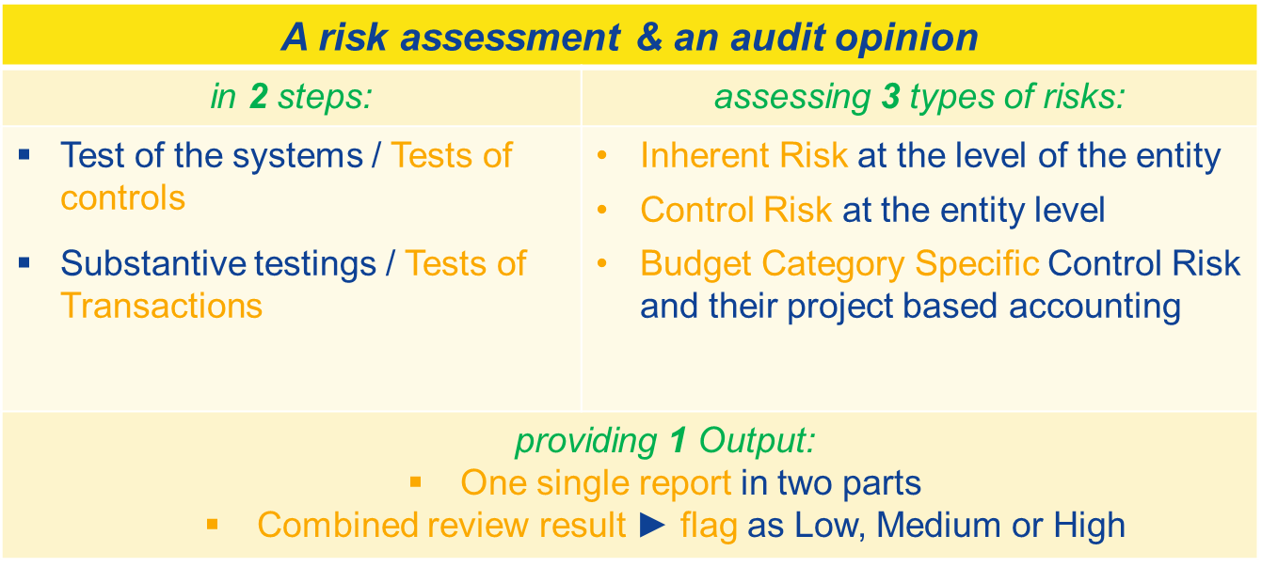
Horizon Europe: System and Processes Audit (SPA)
What is a SPA ?

Slide 42

Horizon Europe: System and Process Audit (SPA)
Who can apply?
Any beneficiary that:
  uses unit, flat rate or lump sum costs or contributions according to documented (i.e. formally approved and in writing) usual costs accounting practices (if any)
  OR
  has formalised documentation on the systems and processes for calculating their costs and contributions (i.e. formally approved and in writing),
  has participated in at least 150 actions under H2020 or Euratom and,
  participates in at least 3 ongoing actions under HE or Euratom.
How?
Step 1 — The beneficiary submits the application in the system which will be assessed by the EC auditors
Step 2 — If application accepted, the EC auditors (directly or indirectly) will carry out the SPA
Step 3 — The audit result will take the form of a risk assessment classification
What benefits for beneficiaries classified as ‘low-risk’?
  less (or less in-depth) ex-post audits AND,
  a higher threshold for submitting CFS (i.e. 725.000 EUR instead of 430.000 EUR)statements (CFS;

Slide 43
Thank you!
# HorizonEU
http://ec.europa.eu/horizon-europe

