Slide 1


PROPOSAL WRITING FOR RESEARCH AND INNOVATION PROJECTS
MS CHRYSOULA PETRITSI

Slide 2
Day 1 Essential Elements of a Successful Project Proposal
    Morning Sessions
Session 1: Overview of the programming period 2021-2027
Session 2: Innovation policy for 2021-2027
Session 3: Exploring the different notions of innovation
Session 4: The best fit between your project and an available funding stream/Call.
    Lunch break
    Afternoon Sessions
Session 5: An overview of winning proposal essential features
Session 6: Putting yourself in the role of the “evaluator
Discussion / questions and answers – are encouraged during all training sessions

Slide 3
Day 2 Good Planning and Control
    Morning Sessions (interactive lecturing, tips and exercises)
Session 1: Working-out the implementation plan
Session 2: Dealing with risk
Session 3: Developing a sound dissemination and exploitation plan
    Lunch break
    Afternoon (workshops)
Discussion / questions and answers – are encouraged during all training sessions

Slide 4
Learning Outcomes
Learn how to break-down a project into Work Packages and Tasks, and find the optimal resource scheduling
Learn the essentials of costing-out/budgeting
Get acquainted with “critical path” management and using “milestones” to monitor project progress
Learn how to identify, avoid and/or resolve risks

Slide 5
Session 1: A well thought-out “workplan”

Slide 6

Why do I need a workplan?
Because it helps me estimate costs
Because it helps me identify the types and quantities of inputs I need
Because it will help me later to implement/manage the project
Because I need to convince the funding agency that I can implement the project effectively
Because it is REQUIRED!
6

Slide 7
A workplan basically consists of …
Actions
Timeline
Resources
7

Slide 8
In other words, you need to define:
The steps required to produce the deliverables which will lead you to the expected result (goal)
The resources to be assigned to each step
The time required to complete each step and the project altogether

Slide 9
What is a Work Breakdown Structure (WBS)?
Let’s see some definitions:
“A deliverable-oriented hierarchical decomposition of the work to be executed by the project team to accomplish the project objectives and create the required deliverables”(Project Management Institute)
“A hierarchical structure of things that the project will make or outcomes that it will deliver” (Association of Project Management)
“A deliverable-oriented breakdown of a project into smaller components” (Wikipedia)
“Project modelling in which the entire job is graphically subdivided into manageable work elements/tasks” (The BusinessDictionary)

Slide 10
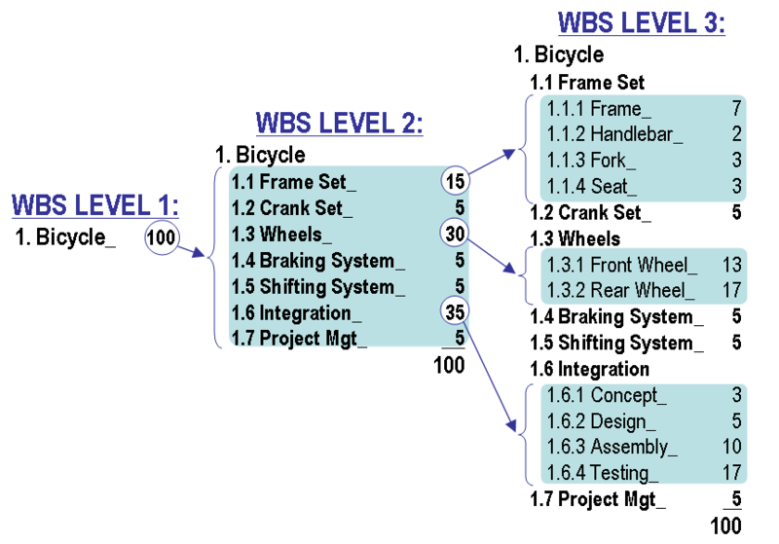
Shall we see some examples?

Slide 11
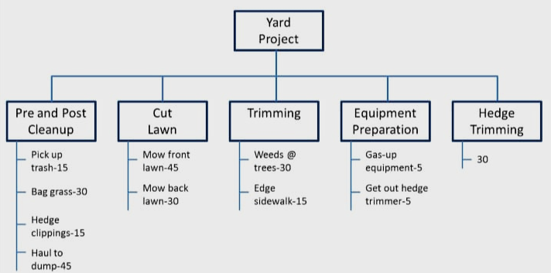
Shall we see some examples?

Slide 12
Work Breakdown Structure (WBS) features
For it to be called a WBS, it must have certain characteristics:
Hierarchy: Each “child/lower” level exists in a strict hierarchical relationship with the “parent/upper” level. The sum of all the “child” elements should give you the “parent” element.
100% rule: Every “child” level of decomposition must make up 100% of the “parent” level.
Mutually exclusive: All elements at a particular level must be mutually exclusive. There must be no overlap in either their deliverables or their work (tasks).
Outcome-focused: The WBS must focus on the result of the work, i.e. the outcomes / deliverables.

Slide 13
Why should I develop a WBS?
WBS is a laser-focused breakdown of all the key deliverables needed to make the project successful:
Project schedule: WBS is the foundation of the timeline and budget. Once you know all the deliverables required to complete the project and their hierarchical relationships, it is much easier to assign resources and set deadlines.
Accountability: Since all elements in a WBS are mutually exclusive, it helps create accountability.
Commitment: WBS gives teams a very high-level overview of their responsibilities. If each team is responsible for a specific component at a time, it helps make them more committed to completing their assigned tasks.
Reduces ambiguities: The process of developing a WBS involves the project manager, project team, and all relevant stakeholders. This encourages dialog and helps everyone flesh out their responsibilities.

Slide 14
How do I develop a WBS?
Excavations/landsc.
Doors/windows
Steel structure
Plumbing
Masonry
Finishes
Electrical
Foundation
Structure
Start with the project scope! Determine your ultimate project outcome. This is you level 1.
Determine major deliverables. This is your level 2. They must be essential for the success of the project and the responsibility of a different team.
Determine work packages (WP) for each deliverable. This is your level 3. Each WP must be:
Independent (mutually exclusive)
Definable (beginning/end)
Estimable (duration/cost)
Manageable (meaningful /measurable)
Integratable (with other WPs)
Adaptable (accommodate changes)
Interiors
House

Slide 15
Let’s develop a WBS for the “Scientific Conference” project
Conference
Deliverable 1
WP 1
WP 2
Deliverable 2
WP 5
Deliverable 3
WP 3
WP 4

Slide 16
Conference sample WBS

Slide 17

Another way of doing it
Is to use a Project Management Software, like:
Microsoft Project
MacProject
Primavera
Scoro
Workzone
WorkBook
FunctionFox
Etc.
Suggestion: redo our exercise on MsProject

Slide 18
Assigning times and resources
Let’s see some definitions:
Duration: how long it takes for something to finish (hours, days, weeks, …)
Effort: the amount of work that goes into finishing a task (person hours, …)
Units: the number of resources it takes for something to get done (persons)
Effort-driven tasks: tasks which require a certain amount of work-effort (personhours) to be completed. For these tasks, if you increase the work effort allocated to the task (longer working hours or more people), you decrease the duration.
  Examples: painting a room, digging a ditch, cleaning potatoes, etc
Duration-based tasks: tasks that take a certain amount of time to be completed. The duration does not change if you increase the work effort.
  Examples: baking a cake, getting a business permit, completing a chemical reaction

Slide 19
Assigning times and resources
Start to assign times at the lowest level of your WBS (i.e. at the task level)
  First, you decide if a task is duration-based or effort-driven
  If duration based, you need to find out how long it usually takes
  If effort-driven, you need to find out how much effort it usually requires..
If using Project Management Software, it will automatically calculate durations for all upper levels of WBS; If not, do it manually. Check with your project time constraints (deadlines). If project fits, don’t change anything.
Decide on task dependencies. (Beware: They may change total project duration!!) Types:
  Consecutive tasks: Finish-to-start (E.g. I need to remove my clothes before I get into the bathtub) or Start-to-finish (E.g. In an e-shop, the sequence of tasks is order placement, order handling, billing, and shipping. Still, billing cannot be completed (i.e. invoice printed) before an employee actually starts to box the order, i.e. before handling actually starts.)
  Concurrent tasks: Start-to-start (E.g. In a waltz, both dancers have to start together) or Finish-to-finish (E.g. finish tying the rebars and placing the forms for making a concrete beam or I cannot bake a cake before the oven is heated-up)

Slide 20
Assigning times and resources (cont.)
Identify project critical path / Identify project milestones for effective implementation
Identify your resource availability
  First, list your resources, unit costs, and availability
  Then note-down their working or operating schedules/constraints (e.g. vacations, sabbaticals, commitments to other tasks, etc)
Allocate resources to tasks. Resolve overallocation problems either by rescheduling tasks or resources. Watch effects on critical path!!!
Check if project fits within time constraints (deadlines0. If it doesn’t you may need to:
  Change sequence of tasks (e.g. make some tasks parallel)
  Add more resources to the project

Slide 21
Let’s continue with our “Scientific Conference” project
Today
1 December
1 January
1 February
1 March
1 April
1 May
Start
Fri 8/11/19
Set Topics
Fri 8/11/19 - Thu 28/11/19
Invite Papers
Fri 29/11/19 - Thu 20/2/20
Select papers
Fri 21/2/20 - Thu 26/3/20
Invitations
Fri 3/4/20 - Thu 9/4/20
Publication
Fri 24/4/20 - Thu 28/5/20
Finish
Thu 28/5/20
Select key-note speakers
Fri 29/11/19 - Thu 23/1/20
Select facility (room)
Fri 24/1/20 - Fri 21/2/20
Registration
Fri 21/2/20 - Thu 16/4/20
Conference Day
Fri 24/4/20
This is the timeline. But how did we get here?

Slide 22
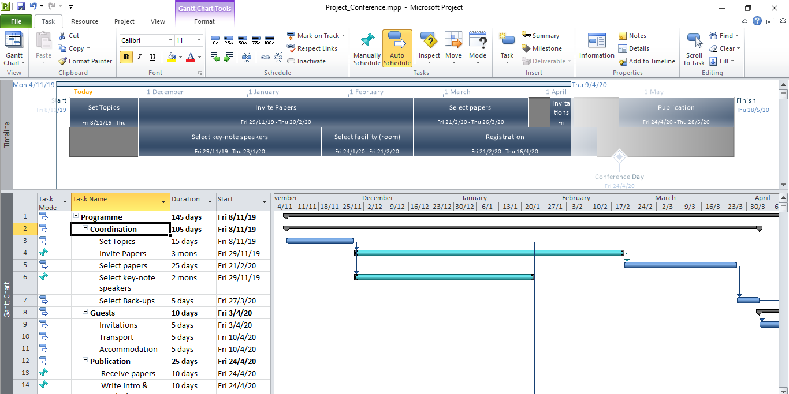
By following the above steps in MsProject

Slide 23
Budgeting
Wait until your Work Packages and Tasks are sufficiently developed.
Estimate costs bottom-up:
  Direct personnel costs: calculate effort and multiply by applicable reimbursement rate to translate into euros.
  Direct costs of subcontracting: estimate on the basis of prior evidence.
  Other direct costs (travel, equipment, goods and services, operating costs): calculate item and multiply by unit price per item.
  Indirect costs: 25% flat rate of the eligible direct costs (i.e. excluding subcontracting and in-kind by third parties)
  Specific costs (if applicable) such as trans-national access to research infrastructure, energy efficiency measures in buildings, costs of clinical studies, : these are reimbursed by means of unit costs or using the lump-sum approach (check it out).
Check justification of personnel costs: is it evident from your Workplan that all the effort you calculated is needed? Have you provided evidence for the unit rates you have used?
Check justification for other direct costs: have you provided evidence for the unit rates you have used?
Indirect costs do not need justification!!
Break down costs by partner OR have each partner do their own budgeting based on the “workplan” and give it to you to aggregate.

Slide 24
Budgeting
Make sure you do not include ineligible costs!
Costs related to return on capital
Debt and service charges
Provisions for future losses or debts
Interest
Currency exchange losses
Bank charges associated with transfer of funds from EU
Deductible VAT
Make sure you do not exceed budget ceiling! (if any)

Slide 25
Budgeting (cont)
Pay attention to:
National Specific Issues
National Regulations affecting the calculation of costs
Your organization rules (they may be different)
If your currency is not Euro, take into account potential exchange rate fluctuations. H2020 rules do not dictate the use of a specific exchange rate for budgeting purposes, so each non-Euro partner organisation must make its own assessment of what is likely to be the actual exchange rate during the implementation of the project.

Slide 26
Session 2: Incorporating Risk Management

Slide 27
First, let’s talk about RISK.
What is RISK?
Exposure to danger? (… proceed at your own risk …)
Possible harm or loss? (… smoking is a health-risk…)
The potential for uncontrolled loss of something of value? (… risk of fire, flood, or other natural disaster …)
A person or thing regarded as a threat? (…a teenage driver on a car policy …)
The possibility of financial loss? (… risky investment …)
The possibility of financial gain? (… risky investment …)
27

Slide 28
Peoples’ preconceptions about RISK
Usually, we think of “risk” with its negative connotation; i.e. it becomes synonymous to exposing oneself to a “threat”, “harm” or “loss”
BUT
Risk can be negative or positive
Usually, we think of “risk” as something we are exposed to, something external
BUT
Risk can be external or internal
28

Slide 29

So, let’s try to define it
AN UNCERTAIN EVENT OR CONDITION THAT,
IF IT OCCURS,
HAS A POSITIVE OR NEGATIVE EFFECT ON ONE OR MORE VARIABLES THAT MATTER
AFTER IT HAS OCCURRED, IT IS NOT A RISK.
IT IS AN ISSUE.
29

Slide 30
Are the following “risks”?
Tomorrow, it may snow.
BUT I am warm inside by the fire!!
Today it’s raining.
AND I have movers coming over!!
A gambler attempts a "double or nothing bet."
A man just lost his job and is unable to pay his rent.
A woman gets into her car and notices that the gas level is low.
BUT she is late to work and has no time to stop at the gas station.
A driver is approaching a yellow light.
AND he chooses to accelerate.
An investor chooses to invest all his savings in mutual funds.
30

Slide 31

Where and how does risk manifest in a project ?
Risk can affect any part of a project:
Scope: experiments show promising results for a more limited range of applications than initially predicted
Budget: price of a critical material goes “through the roof” during implementation
Time schedule: contractors do not deliver in-time, permits are delayed
Level of quality: a lower level of quality is proven realistically possible given the local productive capacity
Partnership: a partner defaults, dies, or is merged
31

Slide 32
What kinds of risks can manifest in a project ?
Technical Risks: product deficient; not-scalable; incompatible tools; patent exists
Market Risks: competition; financing risks; demand not there; expensive product
Legal/Regulatory Risks: no regulatory framework available; product not legal or not up to standard; product easy to counterfeit; product socially unacceptable
Management Risks: unforeseen circumstances; unclear specifications; gaps in design; poorly written contracts; leaks of confidential info
Environmental/safety Risks: accidents; unknown conditions; damage/theft; risks from or to the environment
32

Slide 33

Technical and Market Risks …
Technical Risks:
R&D traditionally focuses on technical risk (i.e. creating a new technology and making it work)
Market Risks:
innovation is about successfully managing both technical and market risk (i.e. creating a useful product/technology, BUT also one that customers want to buy)
Remember?
33

Slide 34
If risk may manifest anywhere … what should I do about it?
It depends on your ATTITUDE TOWARDS RISK
Risk averse: is the attitude where an individual gravitates towards certain, as opposed to uncertain, events. (insurance buyers-civil servants-ageing populations)
Risk seeking/prone: is the attitude where an individual gravitates towards uncertain, as opposed to certain, events. (gamblers-businesspersons-young people-stock market traders)
Risk neutral: is the attitude where an individual has an indifferent attitude towards risk. (farmers-developing country populations)

Slide 35


And risk averse people want … INSURANCE!!
This means that they want YOU to MANAGE RISKS.

Slide 36
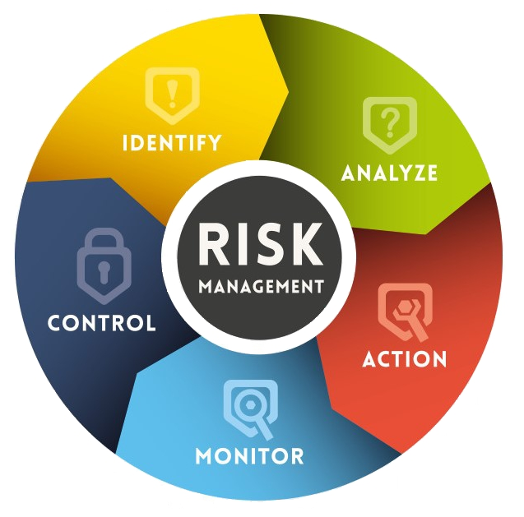
Risk Management
Risk Management is the process of identifying and migrating risk. (i.e. increase the probability of a positive outcome and reduce the probability of a negative outcome)
Risk management is proactive rather than reactive.
Steps:
Risk identification/prioritization
Qualitative & Quantitative analysis
Response/mitigation planning
Monitoring
Control

Slide 37


Risk Identification
1.
Brainstorm / make a list
2.
Identify which risks are more likely to affect your project / make a Paretto chart
3.
Check your assumptions
4.
Concentrate on the highest risks.
MS CHRYSOULA PETRITSI , MS MARIA TIKMANIDI

Slide 38
Qualitative analysis
For each significant risk, assess: likelihood of occurrence (probability), impact on project, urgency of response required
Risk no. | Risk Description | Impact |  |  | Likelihood | Urgency
 |  | Low | Medium | High
❶ |  |  |  | ✓ | 20% | High
❷ |  |  | ✓ |  | 50% | Low
❸ |  | ✓ |  |  | 70% | Low
❹ |  |  |  | ✓ | 50% | Low

Slide 39
Qualitative analysis (cont)
Impact
Make a “probability/impact matrix” and
Rank risks into “important” and “less important”
0% | Low tolerable | Medium undesirable | High Could result in disaster
0-33% Improbable | ❶
34-66% Possible |  | ❷ | ❹
67-100% Likely-certain | ❸
None
Likelihood

Slide 40
Quantitative Analysis
Its purpose is to further analyse and validate your qualitative judgements.
50%
25%
25%
25%
25%
25%
Data
Estimations
Modelling
25%
50%
50%
For all “important risks” perform a quantitative analysis, i.e.
Collect quantitative data (doc.s, expert opinion)
Estimate probabilities/magnitudes
Apply Modelling techniques
    Expected Monetary Value (EMV)
    Critical path analysis

Slide 41
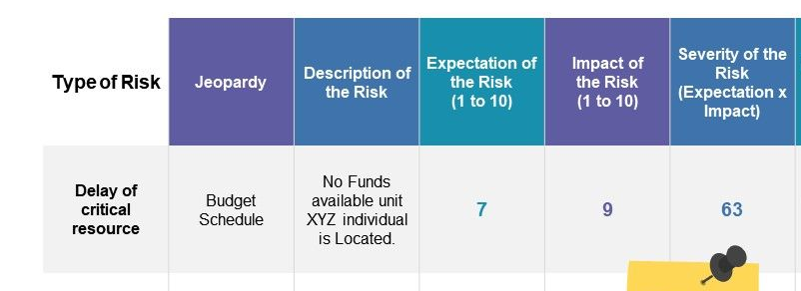
Expected Monetary Value (EMV)
Risk | Probability | Cost Impact | EMV | Classification
A | 20% | -100.000 | -20.000 | Median
B | 40% | +20.000 | +8.000 | Low
C | 60% | -50.000 | -30.000 | High
D | 12% | -360.000 | -43.200 | High
Or expected impact
No funds available until … XYZ event

Slide 42
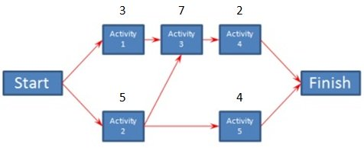

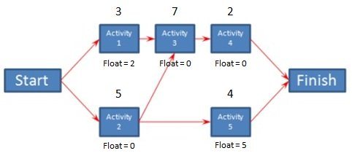
Critical Path Analysis
It applies to project timeplan
The critical path is the sequence of activities with the longest duration. A delay in any of these activities will result in a delay for the whole project.
Once you've identified the critical path for the project, you can determine the float/slack for each activity.
Float/slack is the amount of time an activity can slip before it causes your project to be delayed.

Slide 43
Response/Mitigation Planning
Possible responses to risk:
Avoid risk
Transfer risk
Mitigate/reduce
Accept
Exploit
Share
Enhance
Mitigation
Eliminate threats before they happen
Contingency plan (do something if risk happens)
Fallback plan (do something if contingency plan is not effective)

Slide 44
Risk Management Matrix
Risk | Activity affected | Severity of Risk | Mitigation measure
 |  |  | Elimination | Contingency | Fallback
A (time risk) | Activity 2 | High | Start early | Double-up resources | Use ready solutions/segments
B (budget risk) | Activity 1 | Low |  | Change supplier
C (quality risk) | Activity 3 | High | Pretest materials | Change supplier
D (partner risk) | Activity 5 | Median | Research partner status | Have alternative partner | Undertake activity in-house
Contingency Reserve: budget set-aside to face known risks (contingency plan). It usually appears in project budget.
Management Reserve: budget set-aside to face unknown risks. Usually it does not appear in project budget.

Slide 45
Risk mitigation exercise
Draft a mitigation matrix for the important risks identified during the previous exercise (conference in Brussels)
Risk | Severity of Risk | Mitigation measure
 |  | Elimination | Contingency | Fallback
A
B
C
D

Slide 46

Monitoring and Control
Scheduled re-assessments (to identify new risks)
Trend analysis (to monitor project performance)
Risk Audit (which risks have materialized; how effective was the response/mitigation)
Changes in mitigation plan

Slide 47
Summing up ….
Identify, analyze and prioritize risks
Design mitigation matrix for most important risks:
  Elimination measures
  Contingency measures
  Fallback measures
Estimate and set-aside Contingency Reserve (include in budget)
Estimate and set-aside Management Reserve (do not include in budget)

Slide 48
Session 3: Developing a sound dissemination and exploitation plan – data management plan

Slide 49
Some definitions …
communication
“strategically planned process aimed at promoting the action and its results
targeted measures for communicating about (i) the action and (ii) its results to a multitude of audiences,
dissemination
The public disclosure of the results by any appropriate means
exploitation
The utilisation of results in further research or in developing, creating and marketing a product or process, or in creating and providing a service, or in standardisation activities.”
49

Slide 50

One size does not fit all!!!
Dissemination & exploitation plan is now required at proposal stage,
but
communication, dissemination and exploitation activities vary depending on the project, and so a one-fits-all solution is neither reasonable nor desirable.
50

Slide 51
How to build a successful dissemination strategy
Why you want to disseminate
What is to be disseminated (the “message”)?
What is the most effective way to disseminate (the “means/timing”)?
Dissemination strategy
Which audience do you want to reach (who, where)?
Who are your dissemination partners (people, organizations, networks)?
51

Slide 52
How to build a dissemination strategy in 6 steps
Step 1
Stakeholder analysis: understand who your stakeholders are, what are their information needs and preferences. “A stakeholder is anyone who has a vested interest in the project or could be affected by its outcomes.”
Step 2
Purpose analysis: understand what drives you to disseminate. It could be to raise awareness, to inform, to educate, to change behaviour, to engage, to get feedback/start dialogue, to “sell”/promote, etc. You may have more than one objectives!!!
Step 3
Define audience: develop your “audience” based on stakeholder analysis. Decide who to include: “internal audiences, i.e. people/organizations around the project or in close collaboration”, “practice-based networks, i.e. people/organizations in the same field”, “external audiences, i.e. people who can benefit, opinion-makers, policy-makers, people who can act as catalysts (teachers, librarians, journalists, …)”

Slide 53
How to build a dissemination strategy in 6 steps (cont)
Step 4
Define message: your message should be clear (directly linked to the purpose of your dissemination), tailor-made for your audience, and actionable.
Step 5
Choose methods: select the right dissemination methods to get your message across to your audiences and achieve your purpose. You can use a mixture of traditional methods (newsletters, press releases, journal articles, web sites, conferences, etc) and less typical methods (online discussion platforms, events, workshops, neighborhood meetings, etc.)
Step 6
Plan your timing: decide when different dissemination activities will be most relevant. Timing will depend on the progress of the project as well as on the agenda of the target audience.

Slide 54
Indicative contents of a dissemination plan
Introduction (general principles, objectives and structure of plan)
Analysis of stakeholders
Methodology or knowledge Management/transfer
Data management / IPR management
Purposes of dissemination
Types of dissemination activities (target audience, message, method/tool)
Timeline
Monitoring and reporting on dissemination
Allocation of resources
54

Slide 55
Benefits, if strategy for effective Comm/Diss/Ex is in place
enhance your reputation and help your efforts gain understanding and support (also financially)
Tap into additional funding sources
Discover novel approaches and solutions
Attract potential users of the project results
strengthen the research and innovation landscape in Europe
Sharpen your profile within the scientific community
55

Slide 56
Dos and Don’ts
DOs | DONTs
Know the difference between communication, dissemination & exploitation | Be scared of open data
Know your obligations | Be overambitious
Plan strategically | Stop after the project ends
Integrate into every day activities
Get professional help
Learn from other projects
56

Slide 57
Learning from other projects: example
The “OpenUp” good practices report findings.
Dissemination is participatory and multi-directional
Integral to “open science”
Many channels
Gender and diversity are vital
Experimentation with new methods
Need professional advice
Uptake can be fostered through training
57

Slide 58
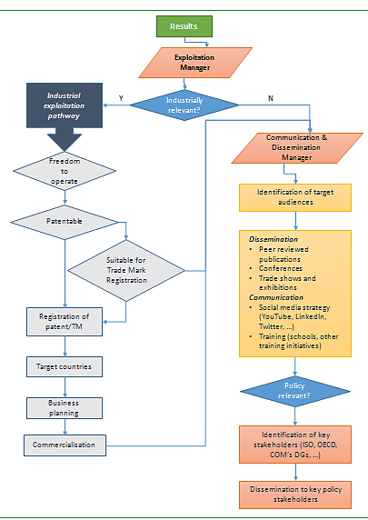
What is exploitation?
Exploitation is the use of results for commercial purposes or in public policymaking.
Can include
IPRs
Collaborations and networking
Open source coding
Available prototypes in academia
Train researchers
Demonstrations to potential users
Production of demos
58

Slide 59
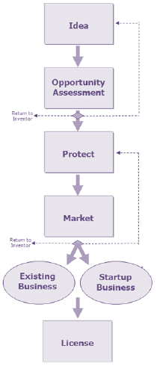


What is commercialization?
It means introducing a new product or production method into commerce, i.e. making it available on the market for purchase. The objective is to come up with products that are sustainable in the long-run.
Commercialization is often confused with sales, marketing, or business development. It is not.
Basically … it has 3 aspects:
Ideation: a plan to go from idea to marketable product. The objective is to come up with product(s) sustainable in the long-run. (must identify: customer needs, price, company skills/production capacities, competition, etc)
Business process: how to set up the production and marketing of the product
Stakeholder engagement: involving e.g. customers
59

Slide 60



Essential questions to be answered …
What is the product and can it win in the marketplace?
Is entry worth it? (profit)
Who is the target customer and how will we reach it?
When and where shall we launch the product?
How will it be delivered to the customer? (sale channels)
60

Slide 61
Commercialization in steps
1.
The Action Plan
2.
Product life-cycle analysis and planning
3.
Strategic management
4.
Profitability analysis
5.
Product performance analysis
61

Slide 62
The action plan
Place
Price
Product
marketing mix: the 7 Ps
pre-launch preparation: general business planning, resources
budgeting
launch and post-launch management: strategic buyers, distributors, in-field support, customer service
Target Market
Promotion
Physical Environment
People
Process
62

Slide 63
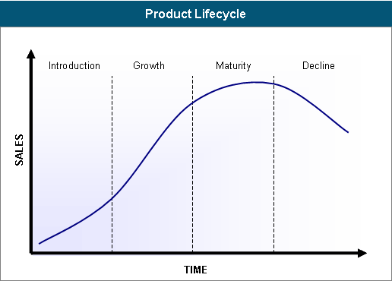
The product life-cycle
4 stages: introduction, growth, maturity, decline.
Marketing Objectives
Introduction: to gain awareness
Growth: to stress differentiation from competition
Maturity: to develop brand loyalty
Decline: to harvest
Extending the product life-cycle
New product variations
New product appearance
New markets
Different sales strategies/points
63

Slide 64

Strategic management
Build product strategy and approach to markets
Approach sales agents
Negotiate contracts
Build product range and pricing
Build marketing systems (web, ads, media)
Go to the market
Sell
64

Slide 65

Profitability analysis
Find the true cost of your product. Include items like: property and equipment leases, loan repayments, utilities, commissions of employees, markdowns, damaged inventory, shrinkage (e.g. shoplifting), employee discounts, etc.
Find how profit differs according to market segmentation: 80% of profit comes for 20% of customer base
Find how it differs according to type of product/service
Make management decisions to increase profits
65

Slide 66

Product performance analysis
Assess:
Product technical performance
Process efficiency (production, market placement, etc)
Customer satisfaction
Financial performance
66

Slide 67
and some other important concepts …
67

Slide 68

The importance of IP (intellectual property)
IP is a fundamental aspect of innovation.
Innovation owners are responsible for ensuring ownership of IP together with their right to grant access to it.
Sharing IP between project partners (i.e. product developers) is necessary for successful exploitation of innovation: thus consortium agreements or joint ownership.
Several ways to protect IP: patent, copyright, trademark, confidential info
68

Slide 69

Knowledge transfer …
is a key output of basic/academic research
It means that:
information and expertise is exchanged with businesses, society and/or the economy
It may occur through:
training of researchers
collaborative or contract research
exploitation of intellectual property
Collaborative research
Collaborative training
people and information exchange services
commercialisation and development activities
69

Slide 70

Potential barriers to knowledge transfer and ways to overcome them
lack of knowledge of potential partners, collaboration mechanisms and funding opportunities, reliability of sources of knowledge
differences in culture, language, and motives
financial constraints, lack of incentives/rewards
Intellectual Property and confidentiality issues (trust)
Lack of time: different operating schedules, location (time zones), etc.
Targeted communication plan for knowledge transfer mechanisms
Actively build collaborative culture within the organization
Provide value and incentives to collaborators
Create relationships
Use technology to implement “seamless collaboration”
70

Slide 71
How to build a data management plan in 5 steps
Step 1
Determine what data will be collected, processed or generated
Step 2
Determine how data will be handled during and after the project: mainly how they will be organized and how they will be documented
Step 3
Define the methodology and standards to be applied and most of all the quality assurance methods.

Slide 72
How to build a data management plan in 5 steps (cont).
Step 4
Determine how data will be stored and preserved.
Step 5
Draft your data policy and mainly which data will be made open and how.

Slide 73
Indicative contents of the data management plan
Introduction (general EU policies, general principles, objectives and structure of plan)
Methodology or Data Management Plan
Data types / datasets
Data management policy (organization, documentation, quality assurance, data security, etc)
Archiving and preservation
Open data / fair data policy (selection of open data, findability, accessibility, interoperability, licensing)
Ethical matters / Confidentiality
Allocation of resources
73

Slide 74
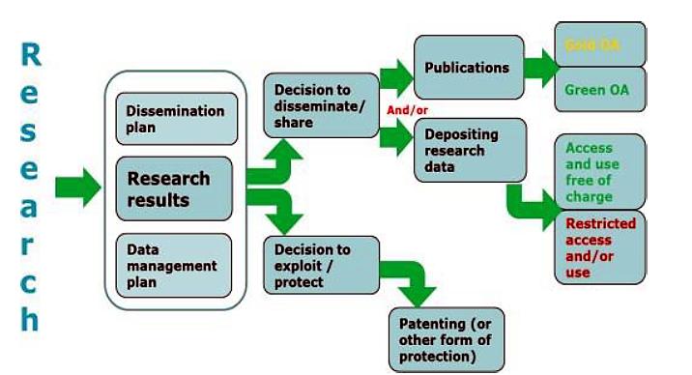
Indicative contents of the data management plan (cont.)
74

